Slide 1


Introduction to
Robotic Process Automation
Automating Event Registration Reminders with UiPath
220701054
Chithra.K
Mrs.J.JINU SOPHIA
Assistant Professor(SG)
Computer Science Engineering

Slide 2
Abstract
The Event Reminder Automation System automates sending reminders for event registrations by scraping details from the Knowafest website and tracking deadlines. It generates dynamic emails with event information and posters, notifying participants 7 and 3 days before the deadline. This system reduces manual effort, ensures timely updates, and improves event participation efficiency.

Slide 3
Need for the Proposed System
Timely Event Reminders: Ensures students receive reminders 7 and 3 days before event registration deadlines, reducing the risk of missing out on important events.
Automation: Automates the manual task of tracking event deadlines and sending reminders, saving time for both organizers and participants.
Increased Event Awareness: Sends dynamic reminder emails with event posters and details, raising awareness and increasing student engagement.

Slide 4
Advantages of the Proposed System
Time-Saving: Automates the process of tracking event deadlines and sending reminders, freeing up time for both students and event organizers.
Timely Notifications: Sends event reminders 7 and 3 days before registration deadlines, ensuring students don’t miss out on registration.
Increased Engagement: Attaching event posters and details in emails keeps students informed and increases interest in events.

Slide 5
Literature Survey
Paper 1:Event Automation
Advantages: Scalability
Disadvantages: Initial cost
Paper 2:Reminder Systems
Advantages: Efficiency
Disadvantages: Dependency on network

Slide 6
Main Objective
The main objective of the Event Reminder Automation System is to automate the process of sending timely event registration reminders to students. This system will:
Scrape event details from the Knowafest website, focusing on registration deadlines.
Send dynamic email reminders to students 7 days and 3 days before event regi
Ensure accuracy and timeliness by automating data retrieval and communication, reducing human error and increasing overall participation in events.stration closes.

Slide 7
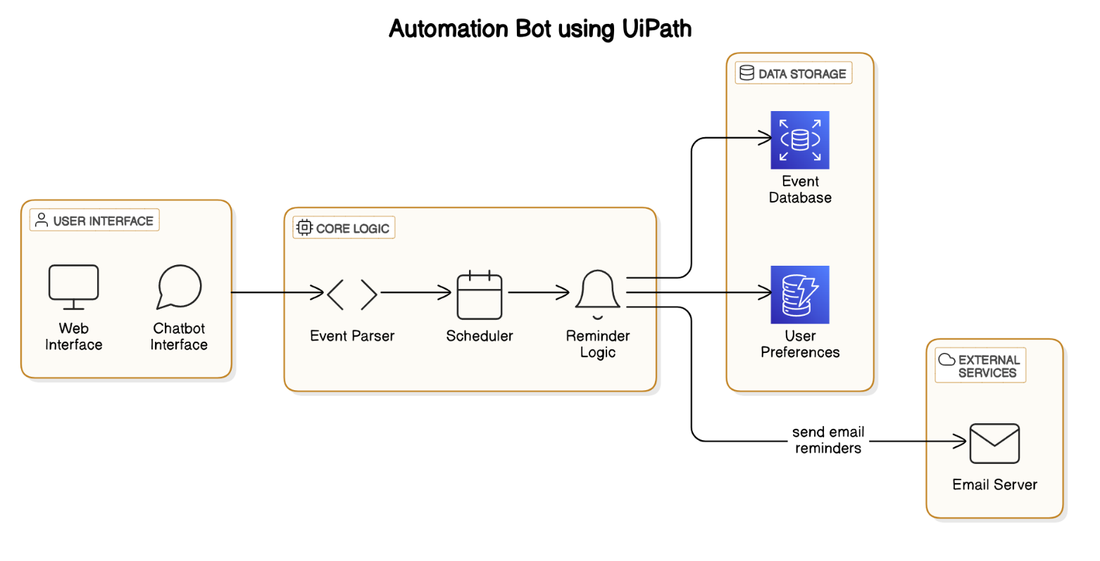
Architecture

Slide 8
System Requirements
Hardware Requirements
Hardware: 4GB RAM, Dual-core processor.
Software Requirements
Software: Windows 10, UiPath Studio, MS Outlook.

Slide 9
Functional Description
1. Web Scraping and Data Extraction
Scrape event details (event name, date, registration deadline, event poster) from the Knowafest website.
Navigate the Knowafest Tamil Nadu events page.
Extract relevant event details.
Save extracted data into a local file or database (e.g., Excel/Google Sheets).

Slide 10
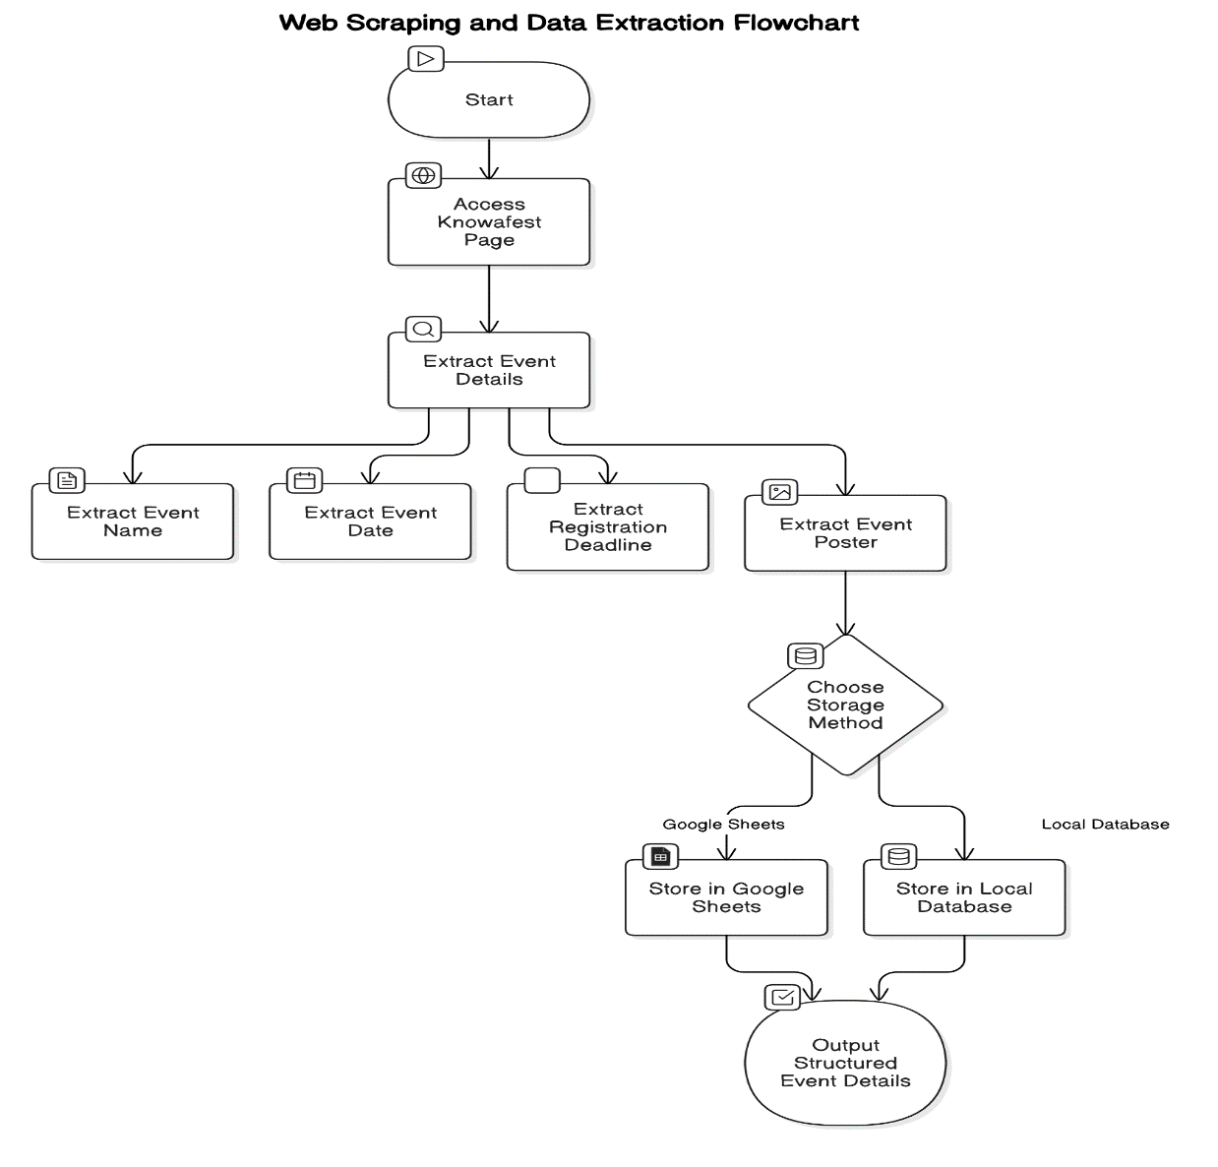
Functional Description

Slide 11
Functional Description
2.Email Notification and Reminder Automation
Send dynamic reminder emails to participants about event registration deadlines.
Calculate remaining days until registration closes.
Generate and send reminder emails with event details and posters attached.
Send reminders 7 days and 3 days before the deadline.

Slide 12
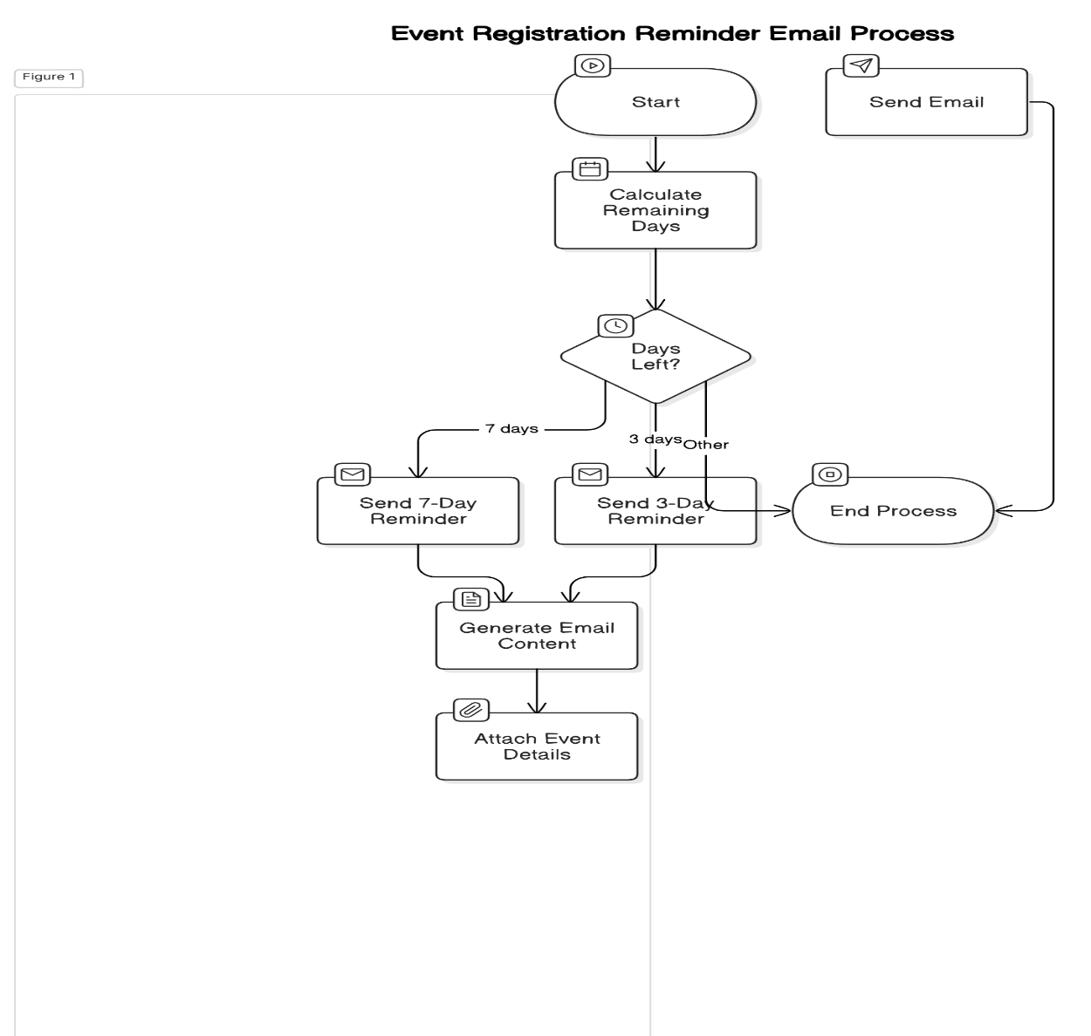
Functional Description

Slide 13
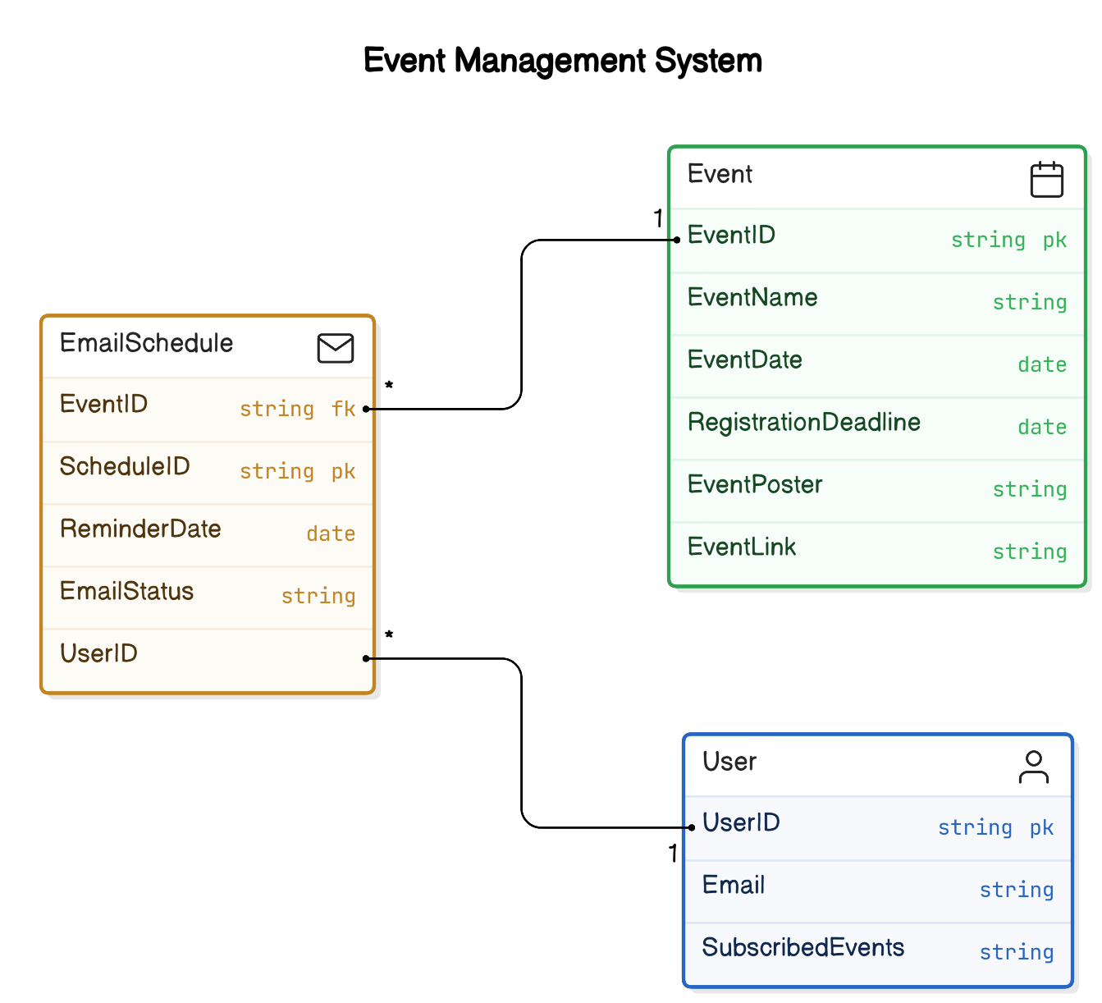
Table Design

Slide 14
Process Design
Main Process
The main process of the Event Reminder Automation System automates the workflow of managing event reminders. It begins by scraping event details such as event name, date, registration deadline, and poster from the Knowafest website and storing them in a database or Google Sheets. The system calculates the number of days until the registration deadline and schedules reminder emails to be sent 7 days and 3 days before the deadline. These emails include event details and posters, dynamically tailored for each event, and are sent via an SMTP email service. The process logs email statuses (e.g., Sent, Failed) for tracking and ensures timely, accurate notifications without manual effort, enhancing user engagement and event organization.

Slide 15
Process Design
Sub process
Event Data Extraction:Scrapes event details such as name, date, registration deadline, and poster from the Knowafest website and stores them in a database or Google Sheets for further processing.
Reminder Scheduling:Calculates the days remaining until the registration deadline and schedules email reminders 7 days and 3 days before the deadline for each event.
Email Notification Generation:Dynamically creates and sends personalized emails with event details and posters attached, logging the status of each email for tracking and reporting.

Slide 16
Implementation
Web Scraping and Data Collection
The first module focuses on automating the extraction of event data from the Knowafest website. The system navigates to the Tamil Nadu events page and identifies relevant event information, such as the event name, date, registration deadline, poster, and link. Once extracted, the data is stored in a Google Sheet or database. This module ensures accurate and structured data collection without manual intervention.

Slide 17
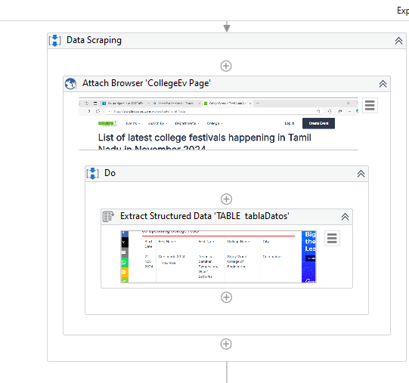
Implementation

Slide 18
Implementation
2. Reminder Scheduling and Notification
The second module automates scheduling and sending email reminders. Based on the event registration deadline, it calculates the reminder dates (7 days and 3 days prior). The system dynamically generates and sends emails, attaching the event poster and including all event details. Sent emails are logged for status tracking and future reference.

Slide 19
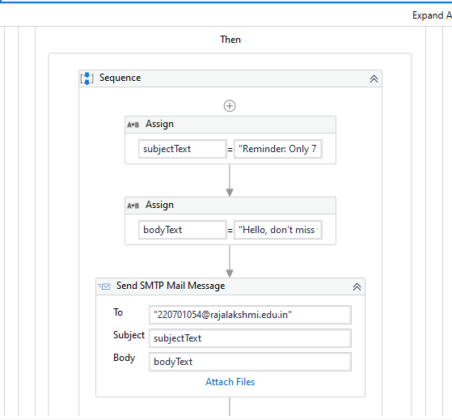
Implementation

Slide 20
Testing
Description
Testing is a crucial phase to validate the functionality and performance of the Event Reminder Automation System. It ensures that all modules, including web scraping, data storage, reminder scheduling, and email notification, work seamlessly both independently and as a whole. Testing involves verifying the accuracy of scraped data, the correctness of calculated reminder dates, and the successful delivery of emails with appropriate content and attachments. Additionally, the system is tested under various conditions, such as handling multiple events and users, to ensure reliability, scalability, and user satisfaction.

Slide 21
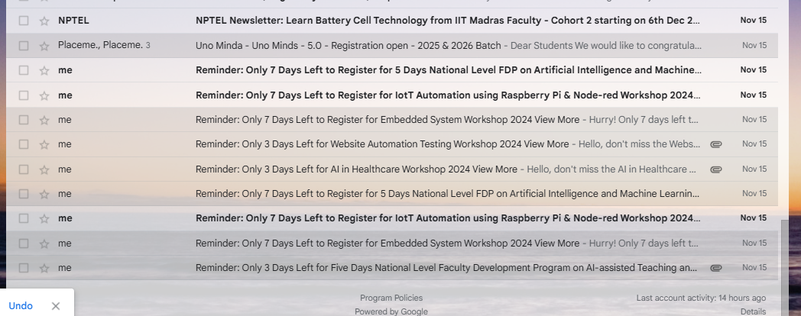
Testing

Slide 22
Conclusions
The Event Reminder Automation System successfully automates the process of event data collection, reminder scheduling, and email notification, minimizing manual effort and ensuring timely delivery of reminders. By leveraging web scraping, data management, and dynamic email generation, the system enhances event participation and improves overall efficiency. The project demonstrates the power of automation in simplifying repetitive tasks and ensuring accuracy, reliability, and scalability in managing event workflows.

Slide 23
Future Enhancement
1.Multi-Language Support:
Extend email notifications to support multiple languages for a broader audience, improving accessibility and user engagement across different demographics.
2.Real-Time Updates:
Implement automated periodic checks to update event data in real-time, ensuring that users receive the most current event information without manual intervention.

Slide 24
References
UiPath Documentation: For web scraping, email automation, and data integration.
https://docs.uipath.com
Knowafest Website: For event data extraction.
https://www.knowafest.com

Slide 25
Queries

Slide 26
Demonstration

Slide 27
Thank You

